Slide 1
UCHALY. SOME WORDS ABOUT THE GEOGRAPHICAL POSITION.

Slide 2
THE UCHALY DISTRICT OCCUPIES THE EASTERN PART OF THE REPUBLIC OF BASHKORTOSNAN. ITS BOUNDARIES ARE FORMED BY THE CHELYABINS REGION, THE ABYALIL AND THE BELORET DISTRICTS. THE TERRITORY OF THE DISTRICT STRETCHES ALONG THE EASTERN SLOPE OF THE URALS. IT IS THE FORTH LARGEST DISTRICT IN THE REPUBLIC.
ITS TOTAL AREA IS LARGER THAN THE AREA OF SOME FOREIGN STATES.

Slide 3
THE UCHALY DISTRICT IS SITUATED WITHIN THE LIMITS OF TWO PARTS OF THE WORLD : EUROPE AND ASIA.

Slide 4
GREAT DIVERSITY OF MINERAL WEALTH
THE UCHALY DISTRICT STANDS OUT SOMEWHAT DISTINCTLY AMONG OTHER DISTRICTS WITH ITS GREAT DIVERSITY OF MINERAL WEALTH:
CHALCOPYRITE
FINE GOLD
ALLUVIAL GOLD
DECORATIVE TILE

Slide 5
BUILDING STONE
LIMESTONE
BRICK CLAY
THE DEPOSITS OF CHALCOPYRITE ARE WORKED BY THE JOINT – STOCK COMPANY “UCHALY CONCENTRATING MILL”,
THE DEPOSITS OF GOLD – BY THE MINDYAK MINE,
LAYERS OF GRANITE – BY THE MANSUR COMBINE OF BUILDING MATERIALS.

Slide 6
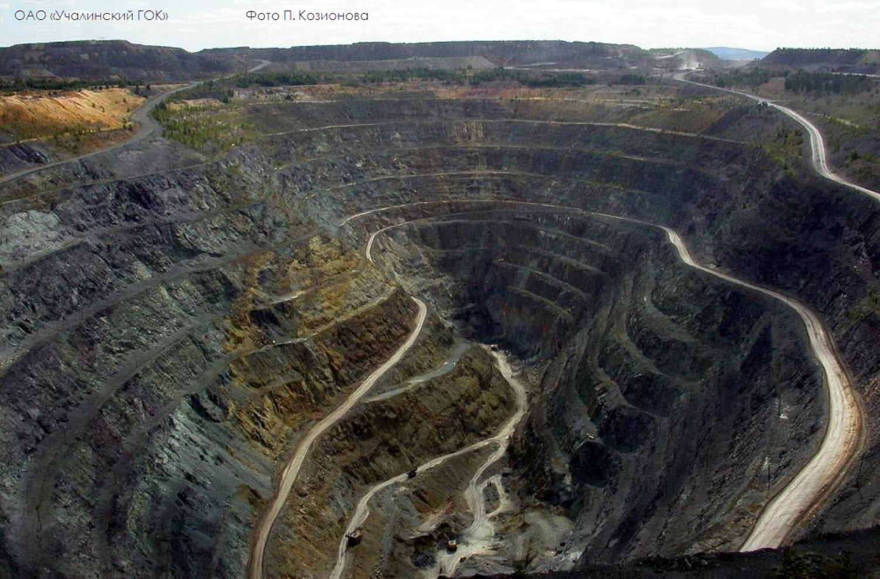

Slide 7
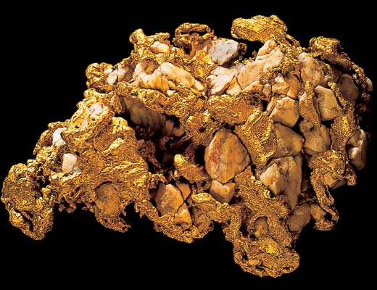
THE UCHALY DISTRICT IS ONE OF THE PLACES IN BASHKORTOSTAN WHERE GOLD IS MINED. IT WAS IN 1797 WHEN GOLD WAS FOUND FOR THE FIRST TIME THERE. THE “GOLD VALLEY” WAS ON THE RIVER TASHKUTARGAN. IT WAS A FANTASTIC DEPOSIT, BECAUSE A POOD OF GOLD COULD BE RECEIVED FROM 100 POODS OF SAND.

Slide 8
THE EMPIRE OF JASPER
SINCE THE XVII CENTURY THE UCHALY DISTRICT IS CALLED THE EMPIRE OF JASPER. THERE ARE 26 DEPOSITS OF JASPER IN THE UCHALY DISTRICT. JASPER WAS WIDELY USED IN MAKING VASES AND BOWLS FOR HIS MAJESTY’S STUDY. THE MAIN STAIRCASE OF THE STATE HERMITAGE IS DECORATED WITH TWO VASES OF THE AUSHKUL JASPER.

Slide 9
IN THE STATE HERMITAGE THERE ARE A LOT OF WONDERFUL VASES, BOWLS AND STANDART LAMPS OF THE TUNGATAR AND MULDAKAY JASPER.
RUSSIAN FOREMEN CREATED INVALUABLE PIECES OF STONE, AMASING THE ARTISTS OF THE WHOLE WORLD.
IN INTERNATIONAL EXHIBITIONS THEY WERE HONOURED WITH HIGHER PRISES.

Slide 11
The Malachite Room

Slide 12
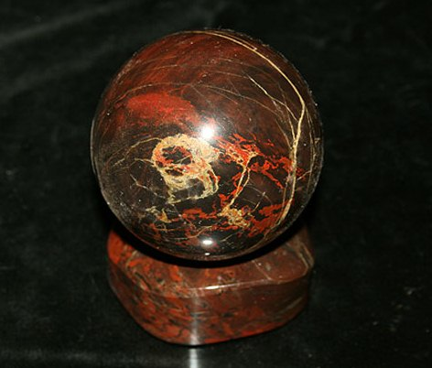
THE ACADEMICIAN A.FERSMAN CALLED THE SOUTHERN URAL JASPER A”SACRED STONE” AND THE KALKAN JASPER – THE SELECTED ONE.

Slide 13
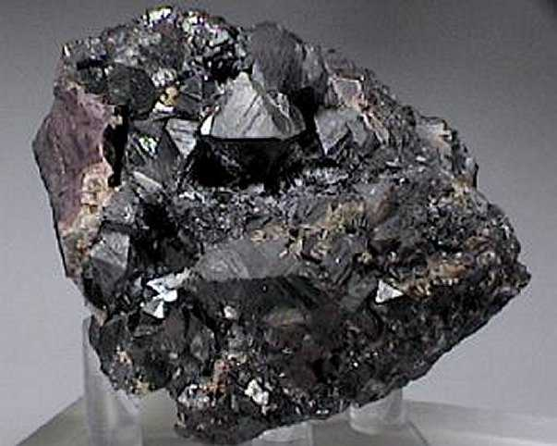
THERE IS A GREY MANGANESE MINE NEAR THE VILLAGE URAZ. DURING THE WAR EVERY SECOND TANK WAS OF MAGNITOGORSK STEEL BASED ON THE URAZ MANGANESE MINE.

Slide 14
GRANIT – THE STRONGEST STONE
ONE OF THE MOST BEAUTIFUL AND STRONGEST STONES – GRANIT IS WIDELY USED IN BUILDING PROJECTS IN THE REPUBLIC AND IN RUSSIA.
THE UCHALY GRANIT WAS USED DURING THE RECONSTRUCTION OF HISTORICAL MONUMENTS IN ST.PETERSBURG IN THE YEAR OF ITS 300 ANNIVERSARY.

Slide 16
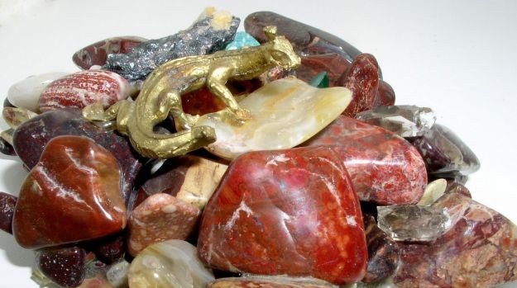
SO, ONE CAN SPEAK ABOUT OUR WONDERFUL LAND ONLY USING THE LANGUAGE OF ALLEGORY:
“GOLDEN CRADLE, KINGDOM OF MINERALS”

